Slide 1
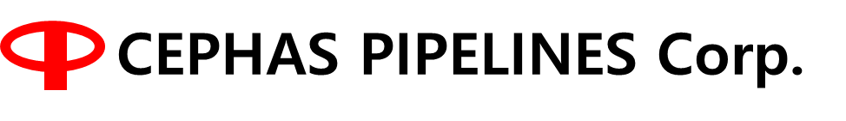
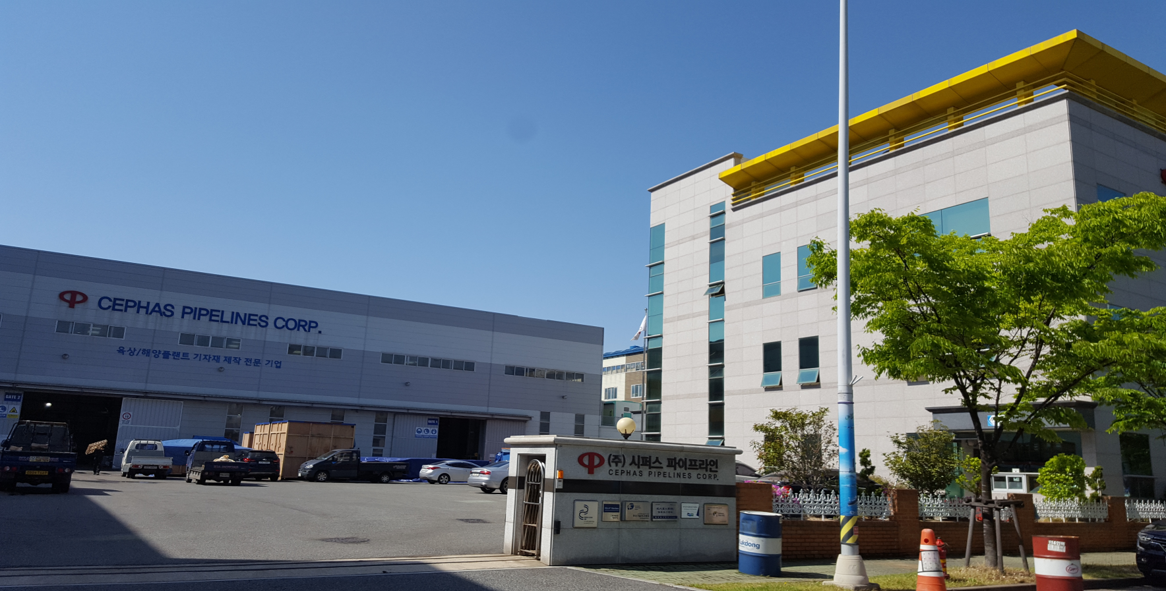

Valve Training Material of CEPAHS

Slide 2

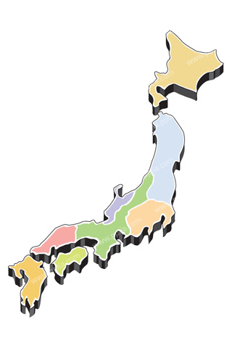
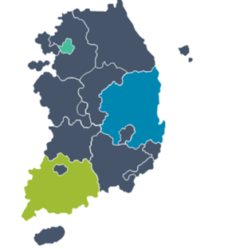
General Information
Company Name | CEPHAS PIPELINES Corporation
Address | 20 Hwajeonsandan 6-ro, 54beon-gil, Gangseo-gu, Busan, Korea
Established | 20, July, 1990
Homepage address | www.cephasvalve.com
President | Masanori Fukumitsu
Main Item | Butterfly Valves
Employees | 93
Factory Size | 12,000 Square Meter
Location

Slide 3
I n d e x
Butterfly Valves
Concentric BTV
Double Offset BTV
Triple offset BTV
Applications
Engineering Solutions

Slide 4
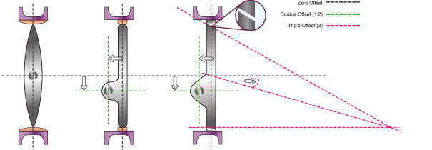
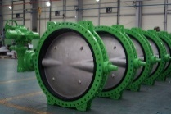

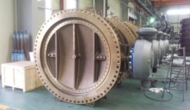
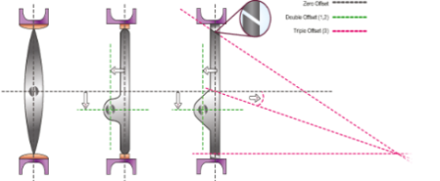
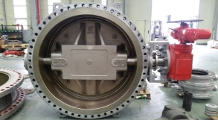
1. Butterfly valves
1.1 Type of Butterfly valves
Applicable Design Pressure : Upto PN16
Flange Rating : 150LB
Because rubber surrounds the body, the choice of body material is easy.
* Seat : Rubber(EPDM, NBR, SILICON, VITON)
Concentric
BUTTERFLY
VALVES
Double Offset
Applicable Design Pressure : Upto PN16
Flange Rating : 150LB ~ 300LB
High Temperature available
Body in contact with fluid : Selection of body material suitable for the fluid to be used.
* Seat : Rubber / PTFE / FELXBLE METAL SEAT
Eccentric
Triple Offset
Applicable Design Pressure : 150LB ~ 2500LB
High Temperature and High Pressure is available
Cryogenic Service available
Body in contact with fluid : Selection of body material suitable for the fluid to be used.
* Seat : Solid Metal / Laminated Metal

Slide 5

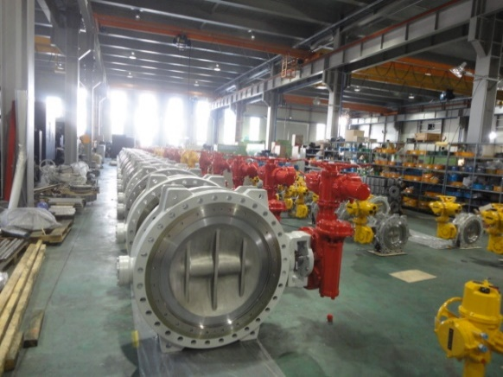

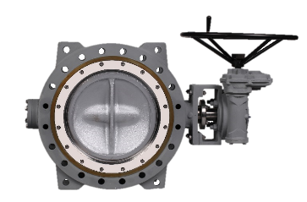
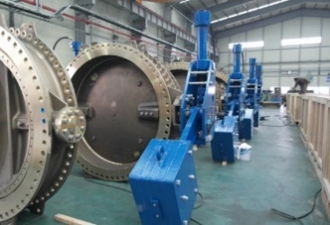
1. Butterfly valves
1.2 Products of Butterfly valves
CONCENTRIC BUTTERFLY VALVE
PRESSURE RATING :
125LB,150LB, JIS 5K,10K,16K
SIZE RANGE :
DN50 ( 2") ~ DN4000 (160")
SEAT MAT'L :
EPDM / NBR / VITON / SILICONE
DOUBLE ECCENTRIC BUTTERFLY VALVE
PRESSURE RATING :
125LB,150LB, JIS 5K,10K,16K
SIZE RANGE :
DN50 (2") ~ DN1200 (48")
SEAT MAT'L :
RUBBER / PTFE / MTEAL+PTFE / METAL
WATER WORKS BUTTERFLY VALVE
PRESSURE RATING :
AWWA C207
SIZE RANGE :
DN80 (3") ~ DN4000 (160")
SEAT MAT'L :
EPDM / NBR
TRIPLE OFFSET BUTTERFLY VALVE
PRESSURE RATING :
150LB ~ 1500LB, JIS10K~30K
SIZE RANGE :
DN80 (3") ~ DN3600 (144")
SEAT MAT'L :
METAL / METAL+GRAPHITE / METAL+PTFE
COMBINED NON RETURN CHECK VALVE
PRESSURE RATING :
125LB,150LB, JIS 5K,10K,16K
SIZE RANGE :
DN80 (3") ~ DN4000 (160")
SEAT MAT'L :
EPDM / NBR

Slide 6


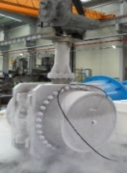

1. Butterfly valves
1.3 Standards & Codes for valve type
ITEM | REF. Photo | Basic Design | Face to Face | Flange Dimension | Test
CONCENTRIC BTV |  | BS EN593 API 609 MSS SP-67 ASME B16.34 | ISO5752 Series 20 API609 Category A JIS F 7480 | JIS B2220 ASME B16.5, 16.47 BSEN 1092 | ISO 5208 API 598
DOUBLE OFFSET BTV |  | BS EN593 API 609 MSS SP-68 ASME B16.34 AWWA C504 | ISO5752 Series 13 API609 Category B AWWA C504 | JIS B2220 ASME B16.5, 16.47 BSEN 1092 AWWA C207 | EN 12266 ISO 5208 API 598 ANSI/FCI 70.2 Class Ⅵ
TRIPLE OFFSET BTV |  | BS EN593 API 609 MSS SP-68 ASME B16.34 | ISO5752 Series 13 API609 Category B AWWA C504 | ASME B16.5, 16.47 | EN 12266 ISO 5208 API 598 ANSI/FCI 70.2 Class Ⅵ
CRYOGENIC BTV |  | BS EN593 API 609 MSS SP-68 ASME B16.34 | ISO5752 Series 13 API609 Category B AWWA C504 | ASME B16.5, 16.47 | API 598 BS6364 MSS SP-134
COMBIND NON-RETURN BTV |  | BS EN593 API 609 MSS SP-68 ASME B16.34 AWWA C504 | ISO5752 Series 13 API609 Category B AWWA C504 | JIS B2220 ASME B16.5, 16.47 BSEN 1092 AWWA C207 | EN 12266 ISO 5208 API 598 ANSI/FCI 70.2 Class Ⅵ

Slide 7
1. Butterfly valves
1.4 product Range
ITEM | REF. Photo | Size | Flange End | Rating | Main Material | Seat Material | Body style
CONCENTRIC BTV |  | DN50 (2“) ~ DN4000(160“) | ASME B16.5, ASME B16.47, AWWA C207D, PN6,10,16, JIS5K,10K,16K | CLASS 125 JIS 5K,10,16K | Cast Iron, Ductile Iron, Carbon Steel, Aluminum Bronze | EPDM, NBR, VITON SILICONE | Wafer, Lug, Flange
DOUBLE OFFSET BTV |  | DN50 (2“) ~ DN1200(48“) | ASME B16.5, ASME B16.47, AWWA C207D, PN6,10,16, JIS5K,10K,16K | CLASS 125,150,300 JIS 5K,10,16K | Carbon Steel, Aluminum Bronze Stainless Steel, Duplex | RUBBER, PTFE, METAL METAL+PTFE | Wafer, Lug, Flange
TRIPLE OFFSET BTV |  | DN80 (3“) ~ DN3600(144“) | ASME B16.5, ASME B16.47, AWWA C207D, PN6,10,16,20 JIS5K,10K,16K | CLASS 150LB~2500LB JIS 5K~30K | Carbon Steel, Aluminum Bronze Stainless Steel, Duplex | METAL, METAL+GRAPHITE METAL+PTFE | Lug, Flange
CRYOGENIC BTV |  | DN80 (3“) ~ DN1200(48“) | CLASS 125,150,300 JIS 5K,10,16K | CLASS 125,150,300 JIS 5K,10,16K | Carbon Steel, Stainless Steel, | METAL, METAL+GRAPHITE RTFE | Flange, Butt-welding
COMBIND NON-RETURN BTV |  | DN80 (3“) ~ DN4000(160“) | ASME B16.5, ASME B16.47, AWWA C207D, PN6,10, JIS5K,10K | CLASS 125,150 JIS 5K,10,16K | Carbon Steel, Aluminum Bronze Stainless Steel, Duplex | EPDM NBR | Flange

Slide 8
1. Butterfly valves
1.5 Features of Butterfly valves
 |  |  |  |  | Expanding Gate valve
 |  |  |  |  |  | Parallel Slide valve
 |  |  |  |  |  |  | Plug valve
● : EXECLLENT |  |  |  |  |  |  |  | Triple offset & Quadruple offset Butterfly valve
○ : GOOD |  |  |  |  |  |  |  |  | Double offset Butterfly valve
 |  |  |  |  |  |  |  |  |  | Trunnion Ball valve
 |  |  |  |  |  |  |  |  |  |  | Globe valve
 |  |  |  |  |  |  |  |  |  |  |  | Gate valve
PROCESS EXPERIENCE |  |  |  |  | ● | ● | ● |  |  | ○ |  |  | Experience of main process use
HIGH PRESSURE |  |  |  |  | ● | ● | ● | ● | ○ | ● | ● | ● | Available in high pressure (above 600LB)
HIGH TEMPERATURE |  |  |  |  | ● | ● | ● | ● | ○ | ● | ● | ● | Available in high temperature (200℃~560℃)
CRYOGENIC |  |  |  |  |  |  |  | ○ | ○ | ○ |  | ● | Great function in cryogenic condition (-196℃)
LARGE SIZE |  |  |  |  | ● | ● | ○ | ● | ● | ○ |  | ○ | Available in large size above DN2000
CAVITY |  |  |  |  |  |  | ● | ● | ● |  | ● |  | Non Cavity structure
RELIABLE SEAT |  |  |  |  | ● |  | ● | ● |  |  | ● | ● | Tightening seal structure
FLOW CONTROL |  |  |  |  |  |  | ○ | ○ | ○ | ○ | ● | ○ | Available in the condition of flow control
OPERATION STROK |  |  |  |  |  |  | ● | ● | ● | ● | ○ |  | Available to quick OPEN/CLOSE based on quarter turn operation
OPERATION TORQUE |  |  |  |  |  | ● |  |  | ● | ● |  | ○ | Available to choose small size actuator
EMERGENCY SHUT-DOWN |  |  |  |  |  |  | ○ | ● |  | ● |  |  | Available to quick OPEN/CLOSE based on quarter turn operation
DBB(DIB) |  |  |  |  | ● | ○ | ● |  |  | ○ |  |  | Follow DBB or DIB definition
SPACE |  |  |  |  |  |  | ○ | ● | ● | ○ |  |  | Compact size compared with other valve
WEIGHT |  |  |  |  |  |  |  | ● | ● |  |  |  | Low weight with piping installation
PRICE |  |  |  |  |  |  | ○ | ○ | ● | ○ |  |  | Competitive price

Slide 9
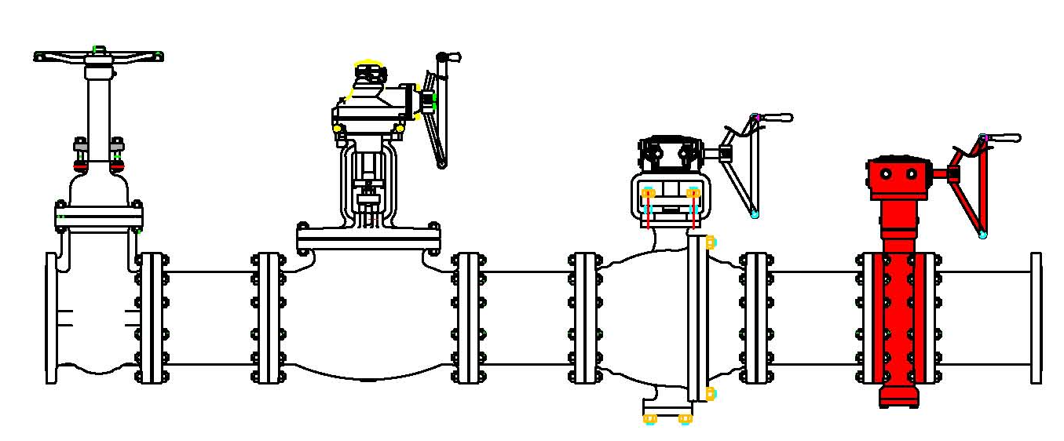
1. Butterfly valves
1.6 Benefits of butterfly valves
▶ Low torques
Low cost of automation.
▶ Easy to replace and install automate
Seat & Valve available to replace
▶ Low cost
Provides the same function to user with
minimized cost
▶ Smaller and Lighter weight
Piping weight achieve to reduce (Gate / Ball / Globe)
▶ Minimized installation space
Compact size more than other valves(Gate / Ball / Globe)
▶ Zero Leakage
Provides reliable zero leakage (API 598)
BUTTERFLAY
GATE
GLOBE
BALL

Slide 10
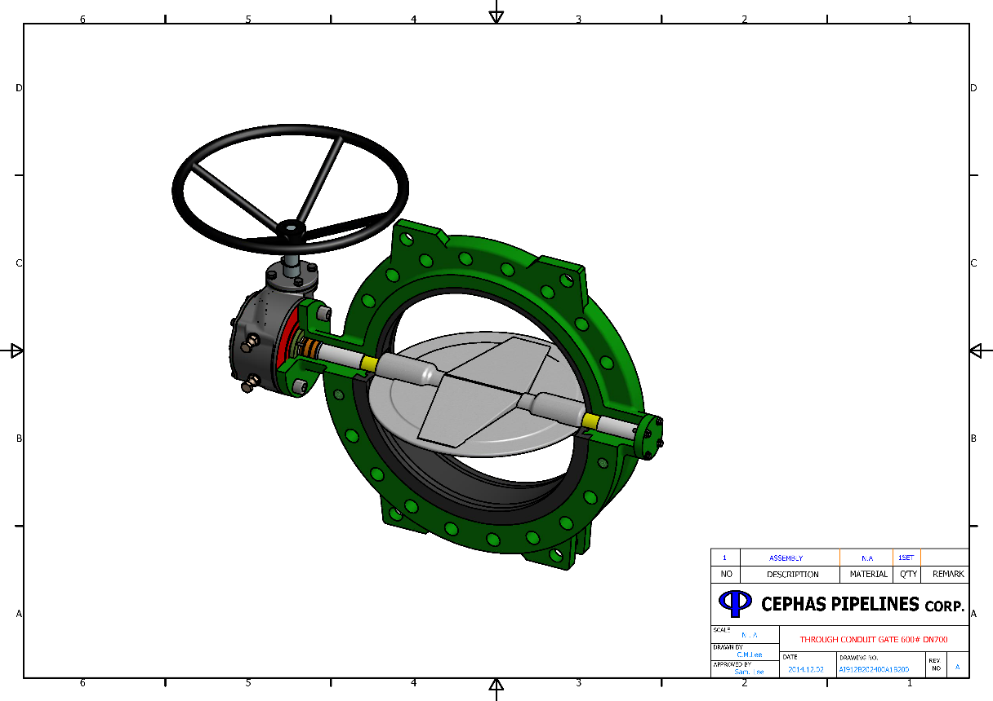
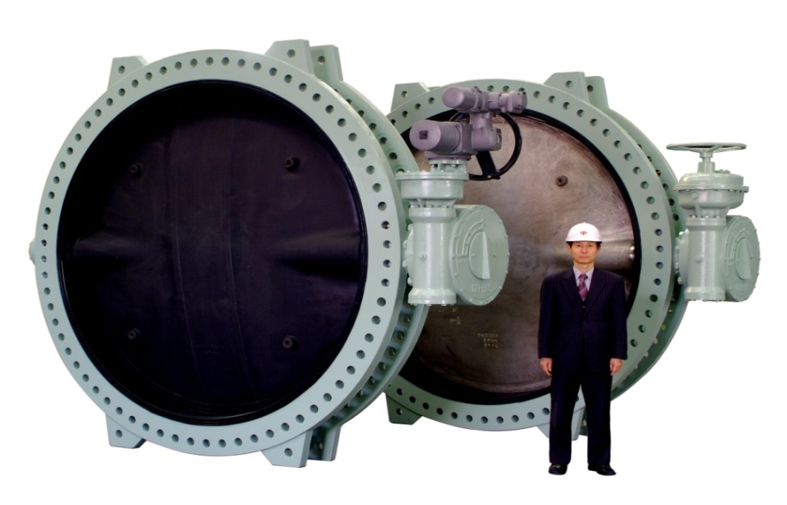
2. Concentric Butterfly valves
2.1 Design Features
- This is the most common and simple design. The shaft is centered to the disc.
It is normally resilient seated valve. Rotating the handle turns the plate either parallel or perpendicular to
the flow of water, shutting off the flow.
Body
Stem(stub)
Bush
End cover
Stem(main)
Disc
Bush
Seat

Slide 11
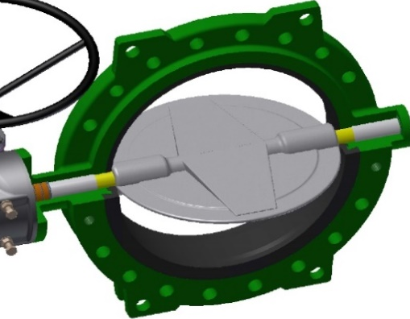
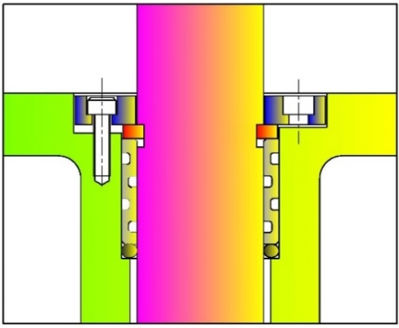
2. Concentric Butterfly valves
2.1 Design Features
· Seat
Easy replaceable seat without any special tools.
Rubber seat is bonded to body. Good integral support, stable and solid, stretch resistant, leakage proof.
Seat to flange seal eliminates the need for gaskets.
· Disc
Precision profile provides bubble-tight shut-off, assures minimum torque and longer seat life.
Disc
· Mounting Flange
Mounting Flange
Seat
ISO 5211 mounting flange accommodates direct mounting of all types of actuators.
· Dry shaft
The design ensures that only the valve disc and seat come into contact with service. In contrast, the shaft, which is positively connected with the valve disc is completely encapsulated. (The shaft is not contacted with service)
.
Retainer plate
· Blow-out Proof Stem
The upper stem is fully retained by the retainer plate under pressure in unlikely event of primary seal fail.
· O-ring
Bush
O-ring
Prevents leakage from stem.
· Bush
Stem bushing reduces valve torque and prevents stem corrosion.

Slide 12
2. Concentric Butterfly valves
2.1 Design Feature - Applicable Material
VALVE TYPE | BODY | DISC | STEM | SEAT
Concentric | Ductile | Ductile | A479 T410 | EPDM
 | A395 Gr.65-45-15 | A395 Gr.65-45-15 | A276 T304 | NBR
 | A536 Gr.60-40-18 | A536 Gr.60-40-18 | A276 T316 | BUNA-N
 | A536 Gr.65-45-12 | A536 Gr.65-45-12 | A564 T630 | VITON
 |  |  | UNS S31803 | SILICONE
 | Carbon Steel | Carbon Steel | UNS S32750
 | A216 WCB | A216 WCB | MONEL K-500
 | Stainless Steel | Stainless Steel
 | A351 CF8 | A351 CF8
 | A351 CF8M | A351 CF8M
 | A351 CF3M | A351 CF3M
 | Aluminum Bronze | Aluminum Bronze
 | B148 C95800 | B148 C95800
 |  | Rubberlined(Coating)
 |  | Natural Rubber (above 18”)

Slide 13
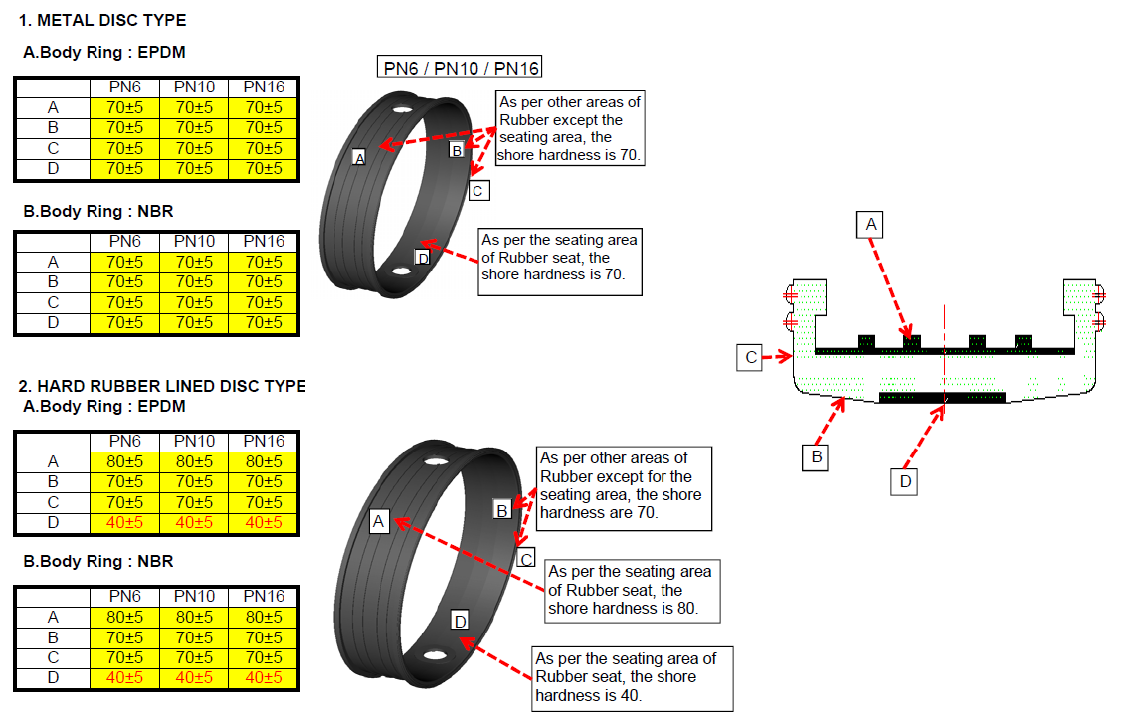
2. Concentric Butterfly valves
2.1 Design Feature – Concentric Seat Hardness for disc material

Slide 14
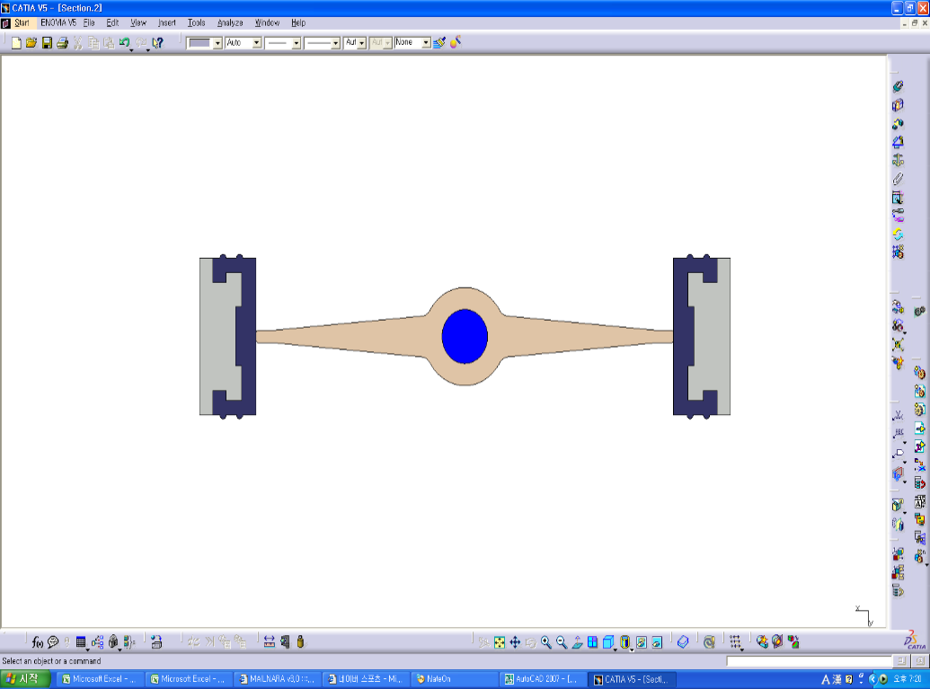
2. Concentric Butterfly valves
2.2 Advantages
Advantage
1) The Rubber seat is completely isolating the valve body.
Therefore, the fluid does not contact the valve body directly.
With this reason, the Ductile Iron or Carbon Steel can be selected for valve body,
even in case of corrosive fluid such as sea water.
( Only disc is contacting the fluid. )
2) The disc is located in Center of valve.
With this specific design of valve, the weight of valve is more lighter than
Double Eccentric or Triple Eccentric BFV.
So, the valve price is much lower than Double Eccentric or Triple Eccentric.
3) Normally, the rubber is selected for valve seat and it is providing 100% zero leakage
at closed position.
4) Design of valve is symmetric design, it is providing the bi-directional tight shut off
5) The packing grand is not required, so it is providing maintenance free for stem packing.
6) The pressure drop is minimized at the full open position.

Slide 15
2. Concentric Butterfly valves
2.3 Disadvantage
Disadvantage of Rubber lined BFV comparing to Double or Triple Offset.
1) There is limitation for temperature, because normally the rubber seat would be limited to withstand the high temp.
2) There is limitation for Pressure, because normally the rubber seat would be limited to withstand the high pressure.
3) In case the seat replacement is required, the valve should be disassembled from the pipelines and
then, valve itself should be disassembled as well.
4) There is a limitation for throttling application.
5) There is a possibility of fluttering of disc at valve open position as the disc is locating in the center of pipe.

Slide 16
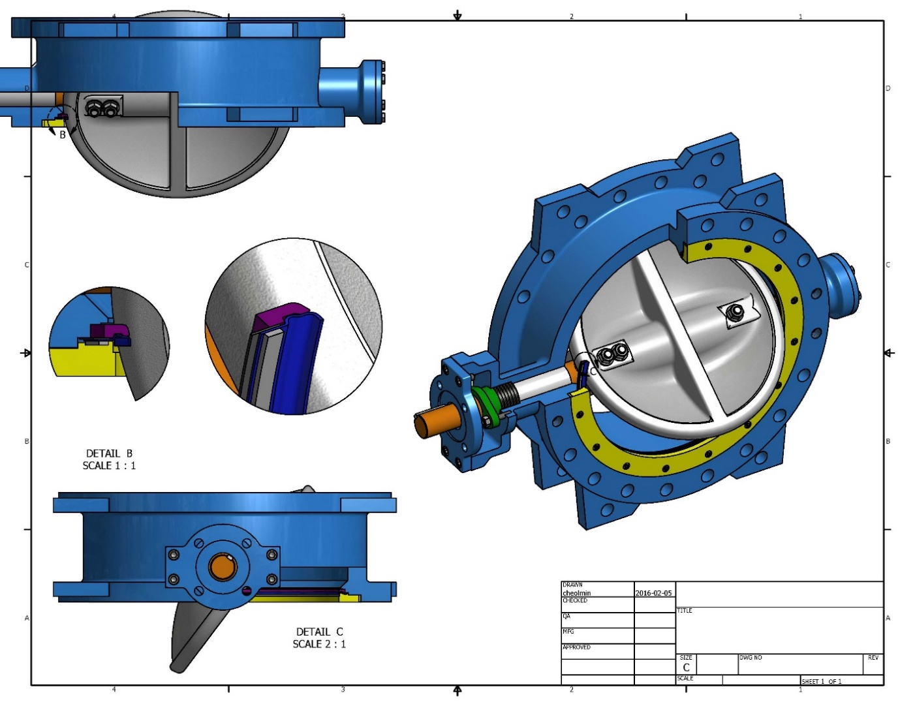

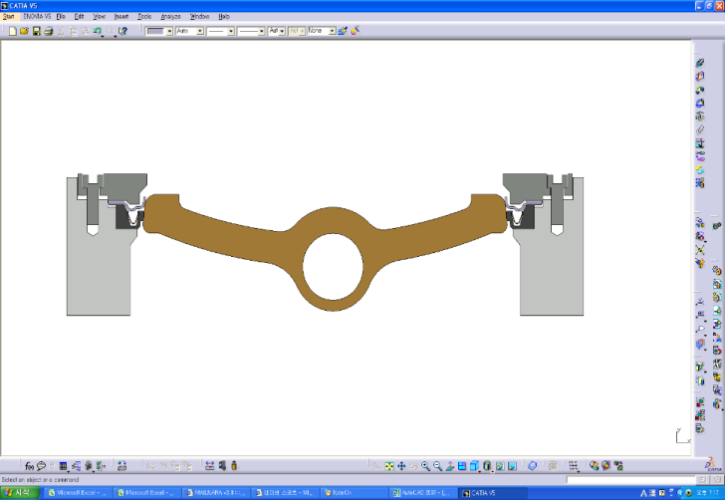
3. Double Offset Butterfly Valve
3.1 High Performance Butterfly Valve - Design Features
- The double eccentric design gives minimal wear of the disc seal, as the disc swings open/close like a door relieving the stress on the seal just after a few degrees of opening. The disc and seat are designed to give the lowest possible operating torque in opening and closing direction at full differential pressure.
Seat
OFFSET _2
End cover
Flange Center Line
Stem Center Line
Packing
Seat gasket
OFFSET _1
- The disc is mounted, in comparison to the body's axis, with double eccentricity, and the body's seat and seal ring are machined according to a cone having an axis aligned with the valve.
In this case a low interference is noticed.
( E1-offset from center of seat )
(E2-offset from center of valve )
Disc
Stem
Bush
Retainer ring
Body

Slide 17
3. Double Offset Butterfly Valve
3.1 High Performance Butterfly Valve Design Feature - Applicable Material
VALVE TYPE | BODY | DISC | STEM | SEAT
Double Offset Butterfly Valve | Carbon Steel | Carbon Steel | A564 T630 | A240 T316L+RTFE
 | A216 WCB | A216 WCB | A276 T304 | A240T316L
 |  |  | A276 T316 | RTFE / PTFE
 | Stainless Steel | Stainless Steel | A276 T420 | EPDM
 | A351 CF8 | A351 CF8 | A479 T410 | VITON
 | A351 CF8M | A351 CF8M | UNS S31803
 | A351 CF3M | A351 CF3M | UNS S32750
 | A890 4A | A890 4A | MONEL K-500
 | A890 5A | A890 5A
 | Aluminum Bronze | Aluminum Bronze
 | B148 C95800 | B148 C95800

Slide 18
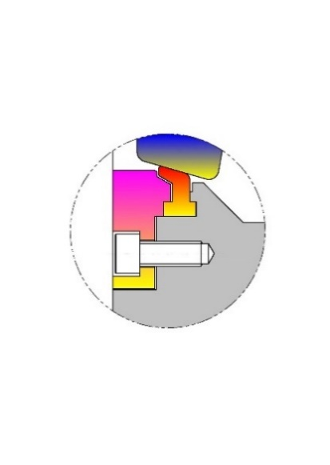
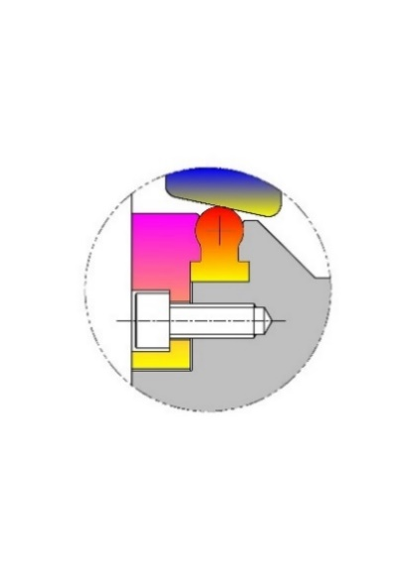
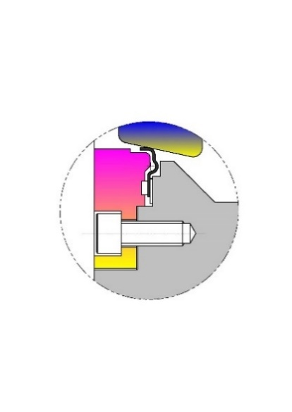
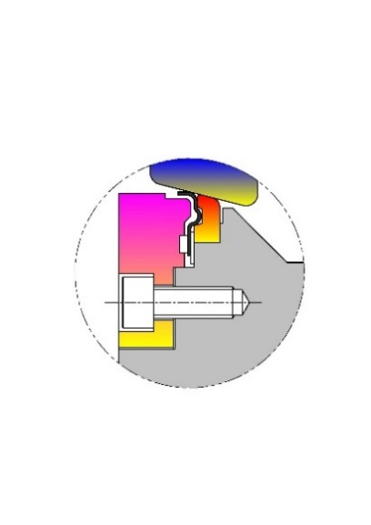
3. Double Offset Butterfly Valve
3.1 High Performance Butterfly Valve - Seat Design Option
Retainer
Disc
Flexible PTFE Seat
Seat
- PTFE seat having a flexi- lip provides bubble tight shut off
in both the directions. Suits to wide range of applications.
Maximum working Temperature 200°C
Retainer
Disc
Flexible Rubber Seat
Seat
- Rubber seats are available in EPDM, NBR and Viton materials.
Rigid seats allow a clean flow passage & prevents fluid deposition
within the seat.
Retainer
Disc
Flexible Metal Seat
Seat
- Most suitable for high consistency fluids having suspended hard
particles, for erosive services, for high temperature services
˃200°C to 550°C.
Retainer
Disc
Fire Safe Design
Seat
- Fire safe valve is equipped with Teflon seat and metal seat at the same
time. It is designed by that before occurring a fire, Teflon seat works for
bubble tight sealing and when a fire occurs and Teflon seat is burned out,
then the metal seat works in order to keep the sealing.

Slide 19
3. Double Offset Butterfly Valve
3.1 High Performance Butterfly Valve - Advantage & Disadvantage
Advantages comparing to Concentric Rubber lined BFV.
1) It can be used for higher temperature than rubber-lined BFV by selecting the Teflon and Metal seat material
2) It can be used for high pressure application.
3) As per the throttling application, eccentric design is much better.
4) In order to replace the seat, only retainer ring is required for disassembling. ( easy maintenance – Large size ).
Disadvantage
1) The fluid is contacting all valve part such as body, disc, seat, shaft, retainer ring.
Therefore, in case of corrosive fluid, the high grade material is required for selection such as
stainless Steel, Ni-Aluminum Bronze or Duplex and so on,.
2) The valve bore is smaller than Concentric rubber lined BFV, and disc is offset,
the Cv Value is smaller than concentric Design.
3) As per detail, please refer to the attached table.

Slide 20
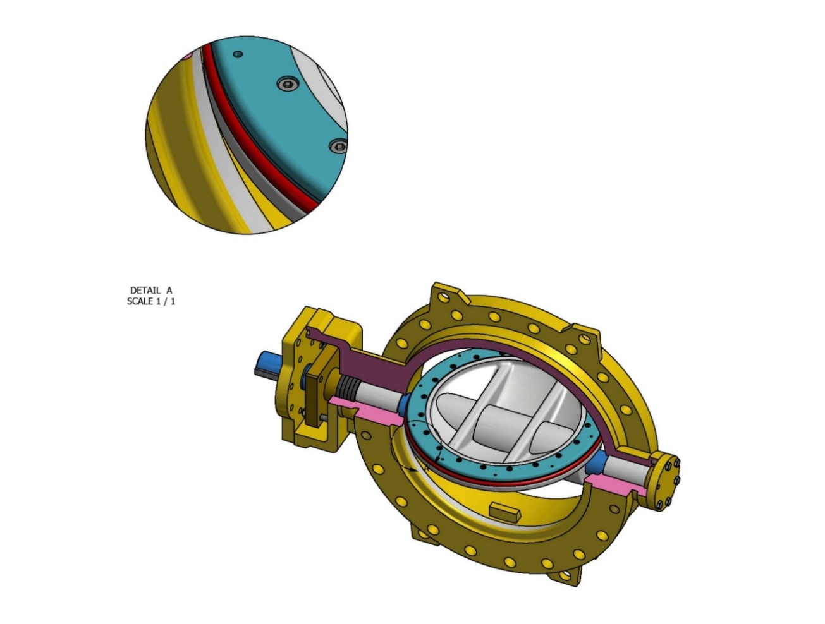
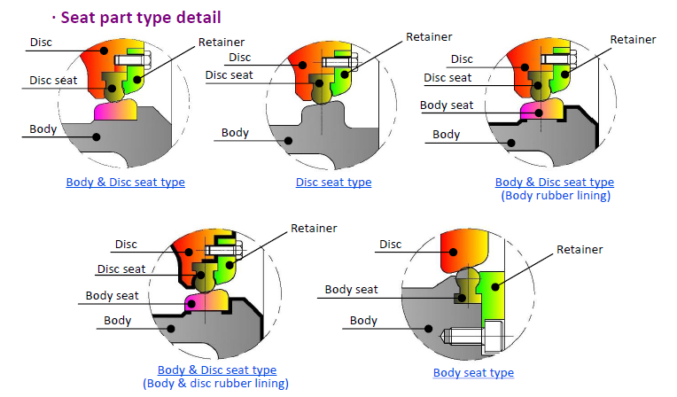

3. Double Offset Butterfly Valve
3.2 Water Works Butterfly Valve - Design Features
The butterfly valve is designed for use in waterworks systems, as well as in process and power industries as a main or end pipe valve. It is a double flanged double eccentric type valve, which can be accommodated to various flange standards (JIS, BS, DIN, ASME)
Retainer ring
Disc
Body seat
Disc seat
End cover
Stem
Packing
Bush
Body

Slide 21
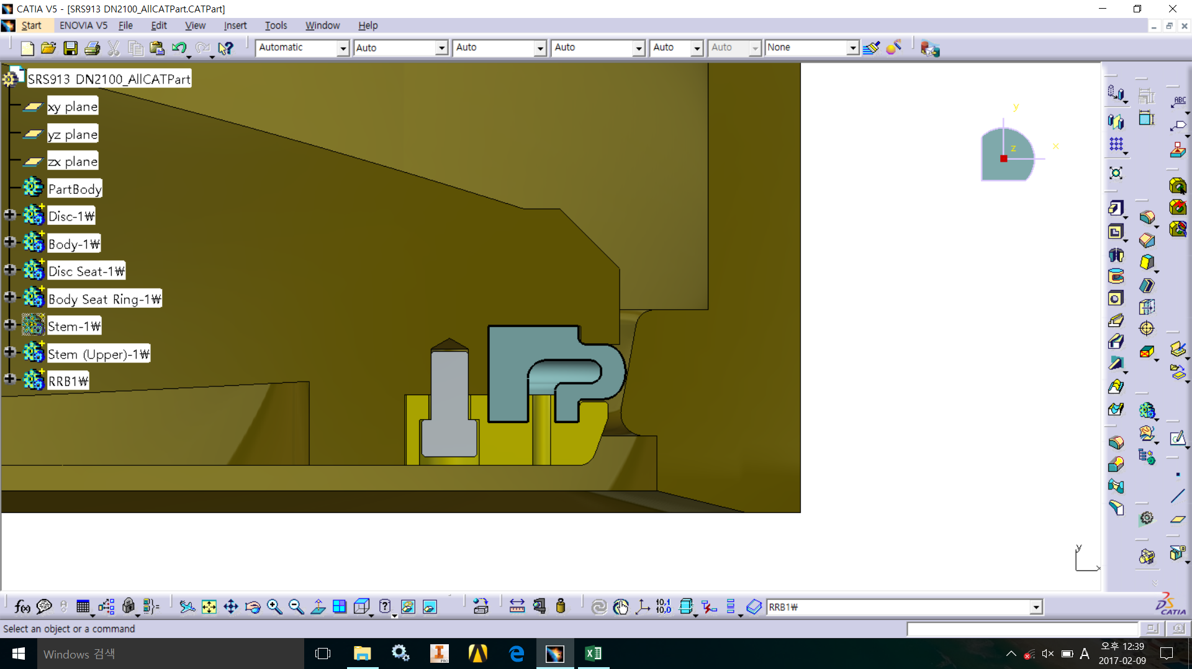

3. Double Offset Butterfly Valve
3.2 Water Works Butterfly Valve - Design Features
OFFSET _2
Flange Center Line
Prefer
Pressure
Non-Prefer
Pressure
Stem Center Line
Prefer Pressure
OFFSET _1
* Advantage
By forming a space inside the rubber seat, it can be realized for bi-directional design by using the non preferred pressure of the fluid.
Since there is a space in the rubber, it increases the elasticity of the rubber and durability.

Slide 22
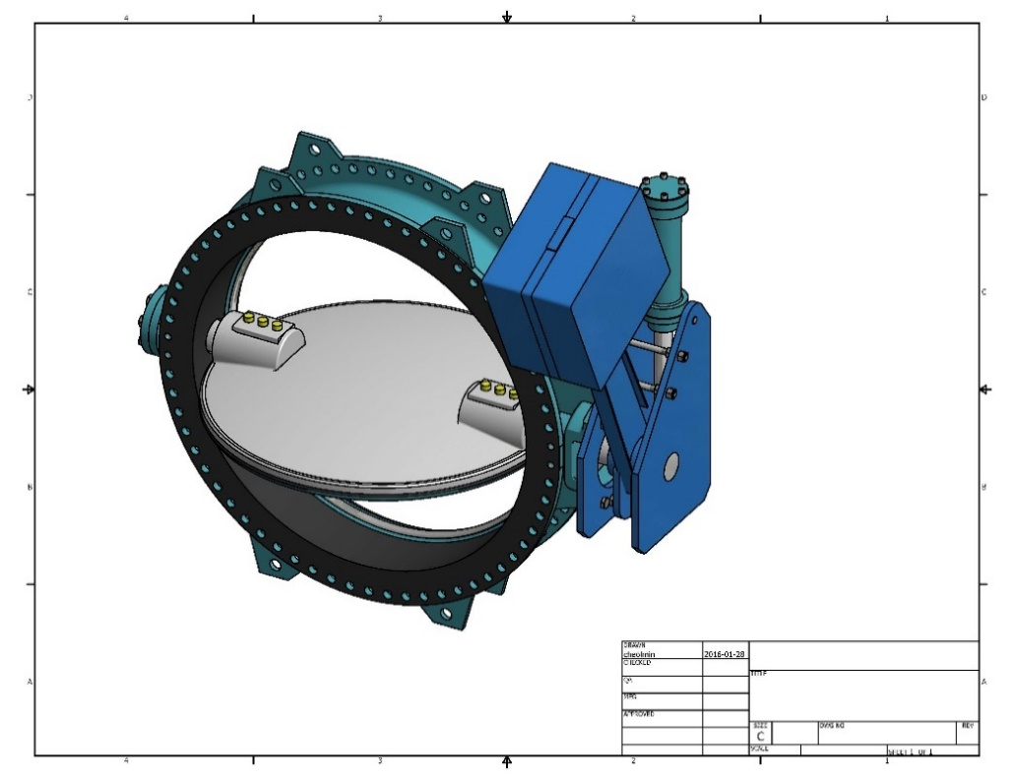
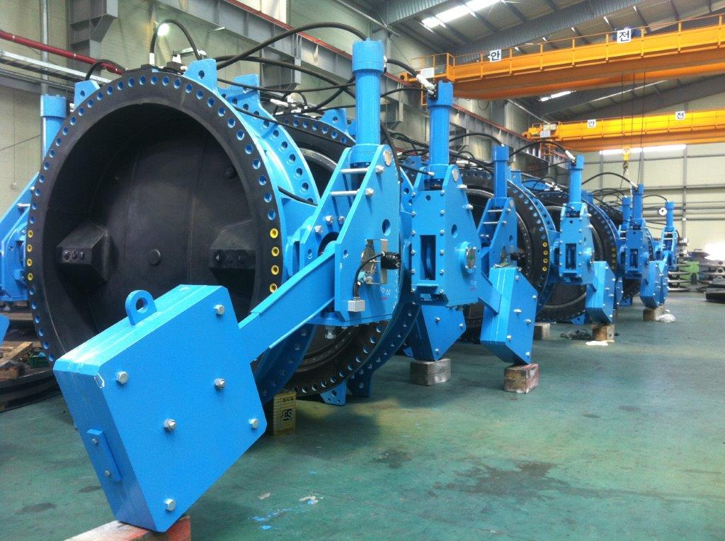
3. Double Offset Butterfly Valve
3.3 Combined Check Butterfly Valves
▶ MODEL NO. : SRS 913 NR
▶ MODEL : SRS913NR
( Actual Product – DN 2800 )

Slide 23
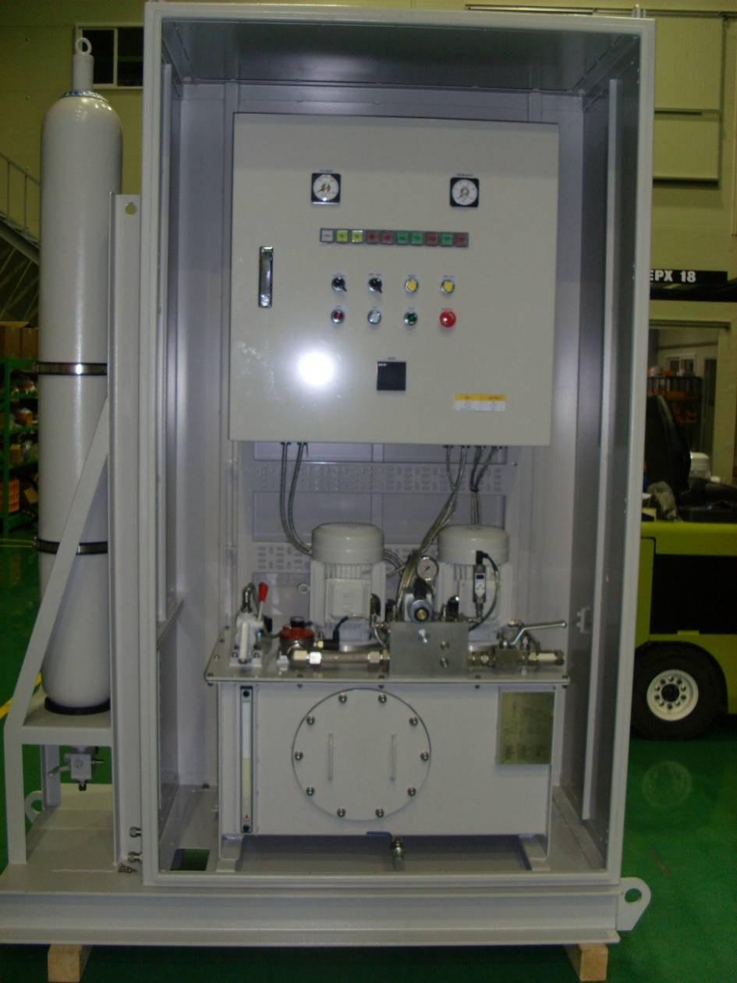
3. Double Offset Butterfly valves
3.3 Combined Check Butterfly Valves
▶ Design feature for Hydraulic Operation
Emergency valve can control the flow direction in order to prevent the breakage of pipes by the reverse flow due to the sudden rising of the flow speed. When ordered by a control device. The closing speed of he valve disc can be adjusted.
• Opening valve / • Closing valve
• Keeping the valve open at the medium degree
• Emergency self-closing (adjustable disc closing time by two steps site adjustment available)
• Emergency valve can be substituted for butterfly valve & check valve
• Controlled closing via counterweigh with controlled speed (single or two stage).
• Valve opening controlled by hydraulic power for arrangement near by or directly to valve equipped with all necessary operating device.

Slide 24
3. Double Offset Butterfly Valve
3.3 Combined Check Butterfly Valves
▶ Name : Hydraulic Power System for Valve Control
▶ Content : Valve operation with different actions by unique hydraulic system
 | COMPETITOR | CEPHAS
Operating Structure | 1. Valve is closed by only weight. | 1. Quick closing at 100%~10% by weight. 2. Slow closing at 10%~0% by hydraulic and weight. 3. Operating time is controlled by 4/3 way type of solenoid valve.
Advantage |  | 1. For quick closing at 100%~10%, mitigated for water shock and vibration of piping. 2. For slow closing at 10%~0%, used the hydraulic and weight for fully closed against back flow. 3. By using only one solenoid valve of 4/3 way type in double coil, it is possible to prevent damage of piping and pump because valve closing is good even in resistance of back flow.
Disadvantage | 1. Large vortex may occur due to back flow in the piping at 10%~0% closing. It means that valve may be not fully closed.

Slide 25
3. Double Offset Butterfly Valve
3.4 Water Works Butterfly Valve & Combined Check Butterfly Valves –- Applicable Material
VALVE TYPE | BODY | DISC | STEM | SEAT
Water Works Butterfly Valve | Ductile | Ductile | A479 T410 | EPDM
 | A395 Gr.65-45-15 | A395 Gr.65-45-15 | A276 T304 | NBR
 | A536 Gr.60-40-18 | A536 Gr.60-40-18 | A276 T316 | SILICONE
 | A536 Gr.65-45-12 | A536 Gr.65-45-12 | A564 T630
 | GGG40 | GGG40 | UNS S31803
 | Carbon Steel | Carbon Steel | UNS S32750
 | A216 WCB | A216 WCB | MONEL K-500
 | Stainless Steel | Stainless Steel
 | A351 CF8 | A351 CF8
 | A351 CF8M | A351 CF8M
 | A351 CF3M | A351 CF3M
 | A890 4A | A890 4A
 | A890 5A | A890 5A
 | Aluminum Bronze | Aluminum Bronze
 | B148 C95800 | B148 C95800
 | Rubberlined(Coating) | Rubberlined(Coating)
 | Natural Rubber (Above 18”) | Natural Rubber (Above 18”)

Slide 26
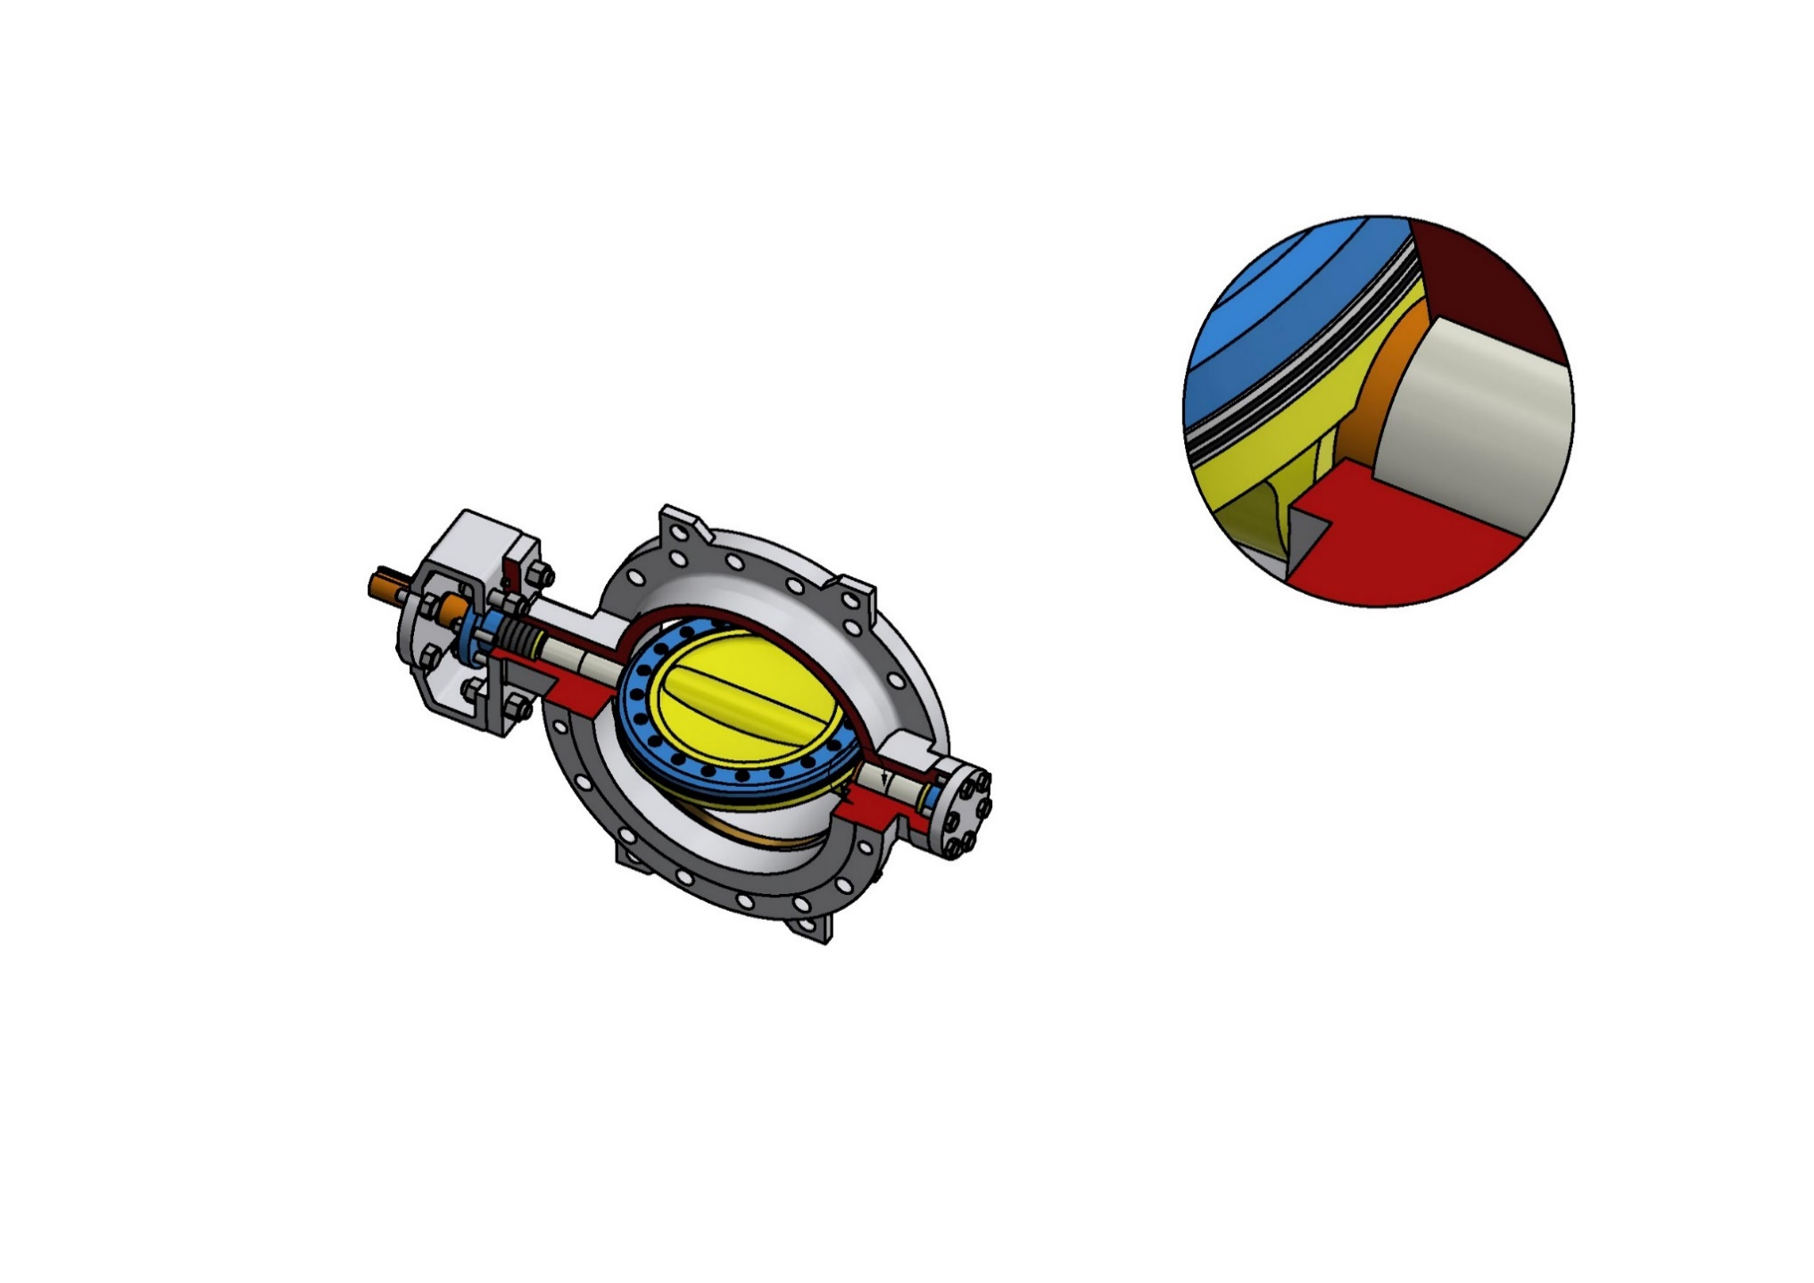
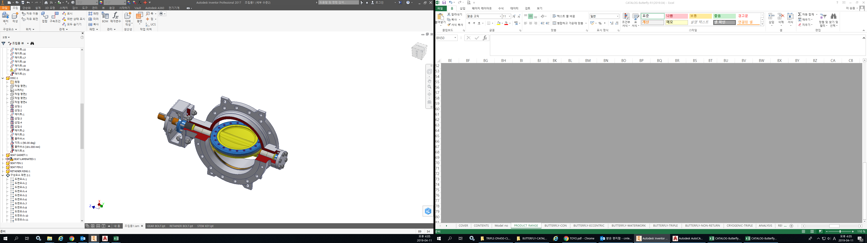
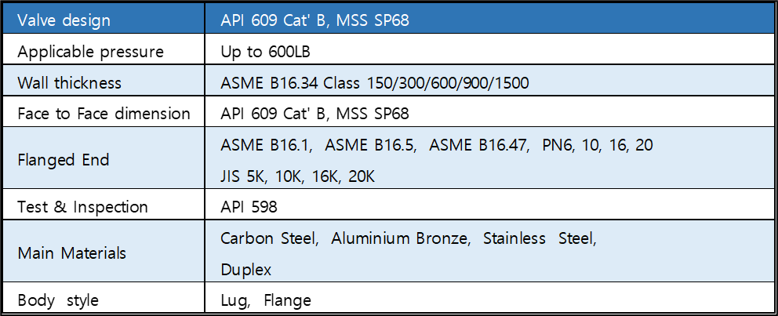
4. Triple offset Butterfly Valves
4.1 Design
The CEPHAS PIPE LINE triple offset butterfly valve are designed in accordance with API609 with features of bi-directional, lightweight, cost effective and low torque. For triple offset butterfly valves, the working temperature range is -196°C ~ 500°C, and there are various materials for choose.
Triple offset butterfly valve can be used not only on-off but also regulating the flow, thus it is replacing traditional gate, globe, ball valve.
Retainer ring
Seat
Retainer ring
Disc
Bush
End cover
Stem
Packing
Bush
Body
Hard facing
Bush
TRIPLE OFFSET METAL SEAT

Slide 27
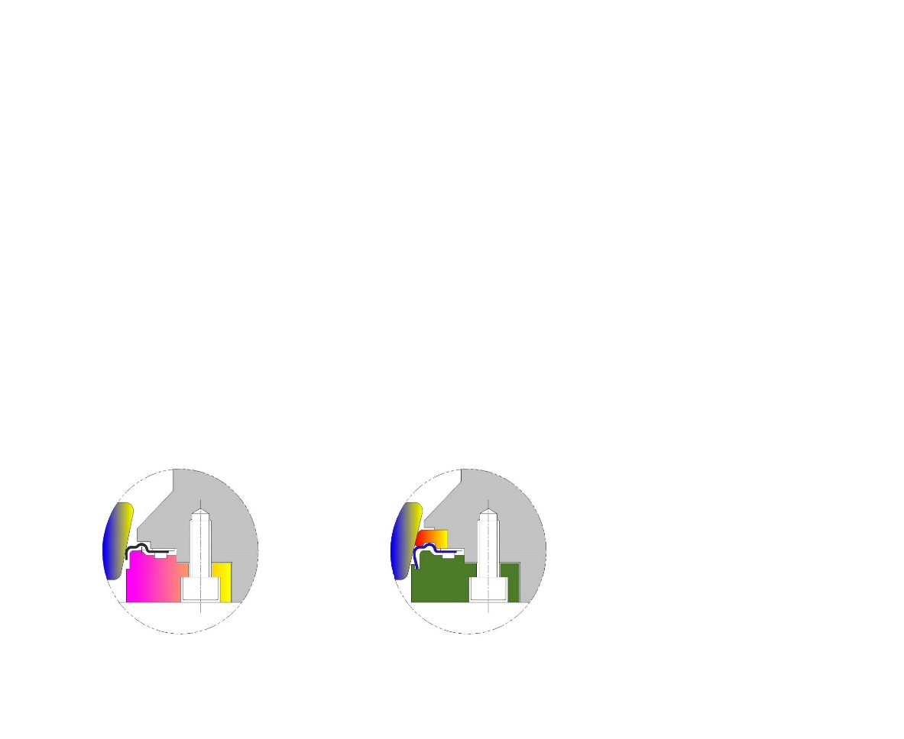
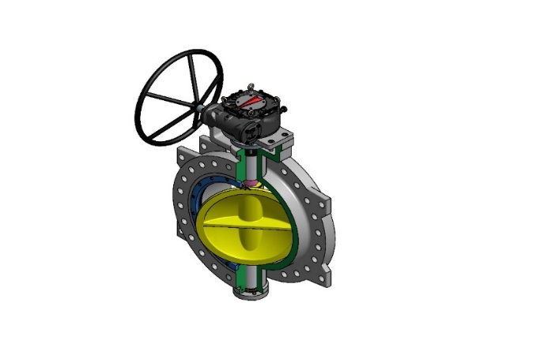
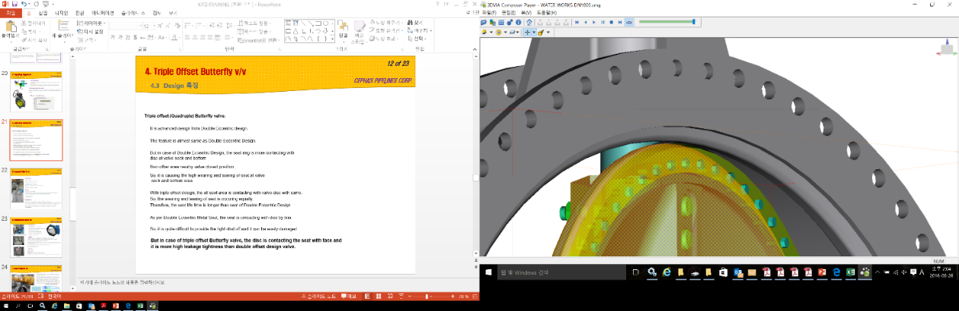

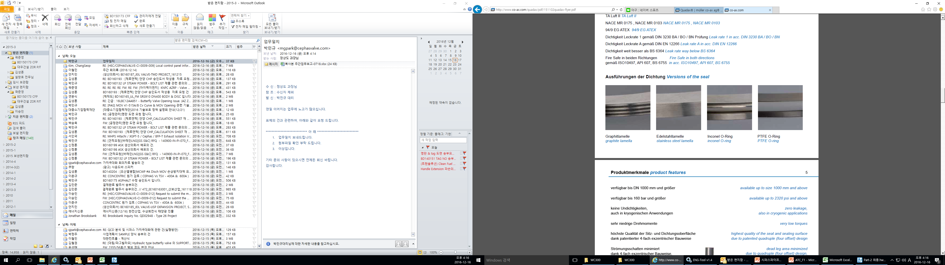
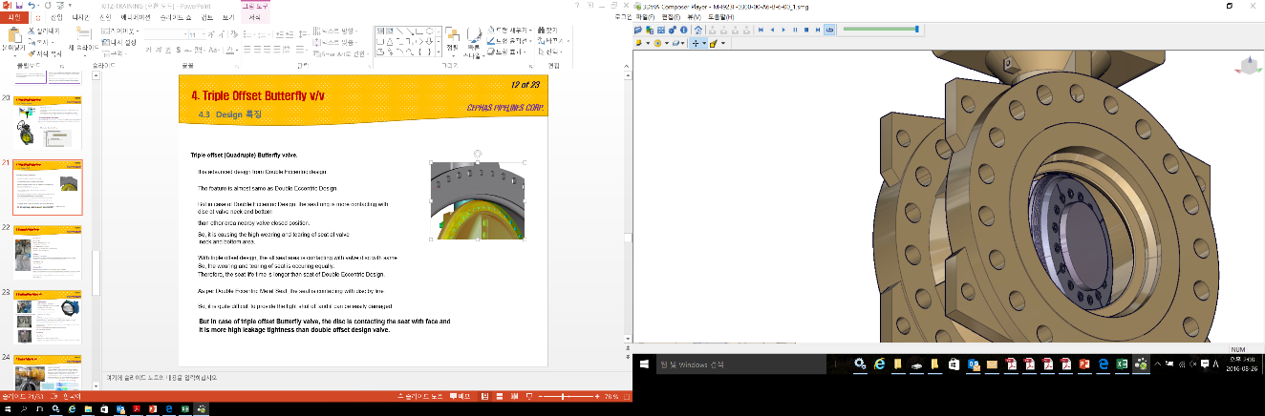
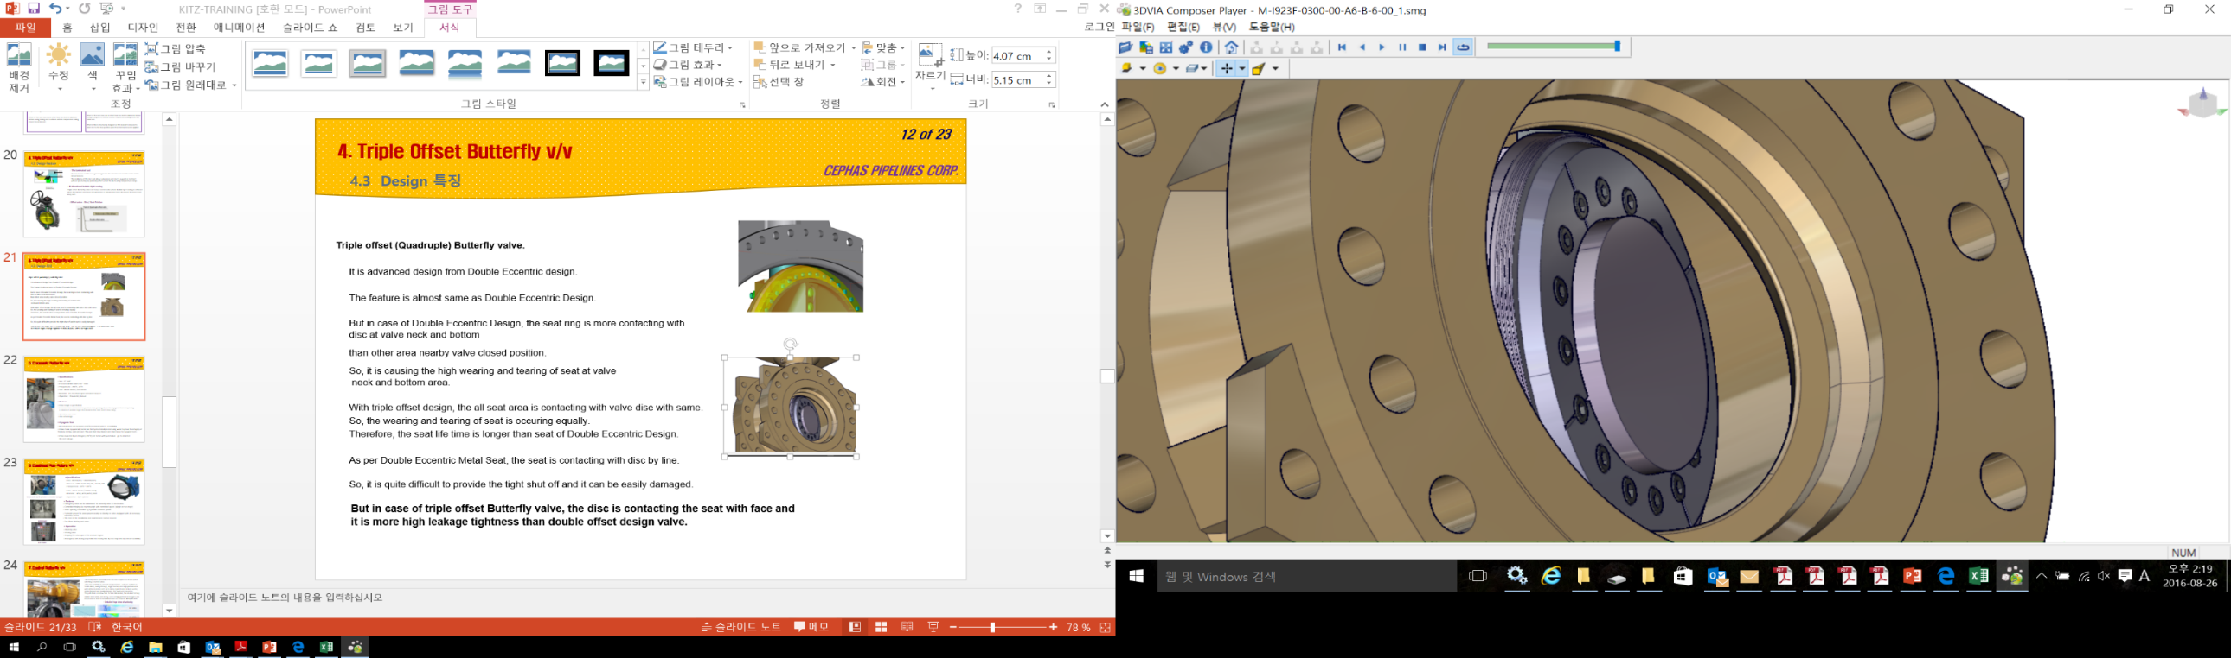
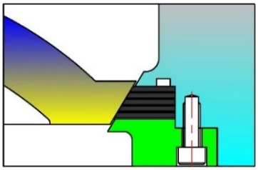
4. Triple offset Butterfly Valves
4.2 Friction Rate of Disc & Seat
Triple offset design has been implemented to make it applicable to high temperature/ high pressure by zeroing the interference of disc and seat during valve operation.
OFFSET _2
Flange Center Line
Stem Center Line
DOUBLE OFFSET METAL SEAT
OFFSET _1
METAL seat
(Laminated or metal seated)
TRIPLE OFFSET METAL SEAT

Slide 28
4. Triple Eccentric Butterfly valves
4.2 Design Feature - Applicable Materials
VALVE TYPE | BODY | DISC | STEM | SEAT
Triple Offset Butterfly Valve | Carbon Steel | Carbon Steel | A564 T630 | A240 T316L+GRAPHITE
 | A216 WCB | A216 WCB | A276 T304 | A240T316L
 |  |  | A276 T316 | A240 T316L+RTFE
 | Stainless Steel | Stainless Steel | A276 T420 | RTFE / PTFE
 | A351 CF8 | A351 CF8 | A479 T410
 | A351 CF8M | A351 CF8M | UNS S31803
 | A351 CF3M | A351 CF3M | UNS S32750
 | A890 4A | A890 4A | MONEL K-500
 | A890 5A | A890 5A
 | Aluminum Bronze | Aluminum Bronze
 | B148 C95800 | B148 C95800

Slide 29

4. Triple offset Butterfly Valves
4.3 Triple Offset Seat VS Double Offset Seat
DOUBLE OFFSET
The disadvantage is that the interference between DISC and SEAT during the valve operation can not be eliminated.
Therefore, the metal seat must be made to be flexible to allow the interference, and the thickness of the metal seat is limited which is not a suitable design for high temperature and high pressure.
DOUBLE OFFSET - METAL SEAT
TRIPLE OFFSET
The interference between DISC and SEAT is completely eliminated during the valve operation.
The strength of the metal seat required for high temperature/ high pressure can be easily designed with excellent durability.
TRIPLE OFFSET - METAL SEAT

Slide 30
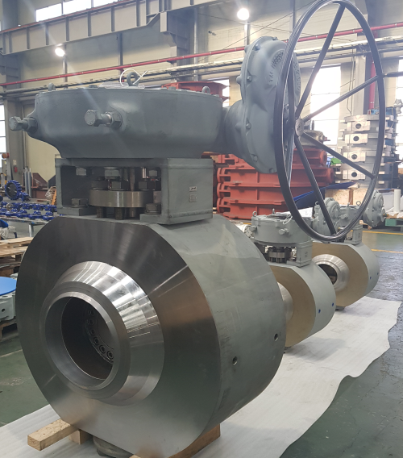
4. Triple offset Butterfly Valves
4.4 Triple offset Metal Seated BTV – Cephas 9**-TE Series.
1. Low Torque seated
17. World class After Services
2. Zero leakage bi - directional
tight shut-off
16. Low maintenance Design
3. Solid metal to metal seat
15. Smaller to Large size
( 80A to 4000A )
4. Resilient metal
to metal seat (Laminated)
14. Low cost
5. Global user based on
Code & Standard
13. Quarter – turn
friction-free Operation.
6. Pressure range
ANSI class 150LB to
ANSI class 2500LB
12. Long Operational life time
11. Temperature range
-196℃ ~ 600 ℃
7. Fire-safety Design
API 607
10. Anti-blowout device
API 609
8. Easy to replace
the valve
9. Wide range of materials
with cladding

Slide 31

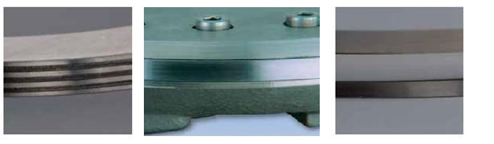

4. Triple offset Butterfly Valves
4.5 Seat Design
Seat is designed based on Fluid Condition (Temp’ / Pressure / Material)
Disc
Body
Gasket
Body seat or Disc seat
(Laminated or metal seated)
□ Laminate Seat
Metal + Graphite
□ Laminate Seat
Metal + PTFE
□ Solid Metal Seat
· The laminated seal
The laminated seal flexes & get energized in the direction of seal all over its entire circumference.
The resiliency of the disc seal allows valve body and disc to expand or contract without producing any jamming effect under the fluctuating temperature range.
· The Solid metal seal
Used in more high temperature and pressure than the laminated seal.
· Bi-directional bubble-tight sealing
Triple offset Butterfly valves are torque seated valve where bubble tight sealing is achieved
when the laminar seal flexes and generates a compressive force all around the hard faced
body seat.

Slide 32

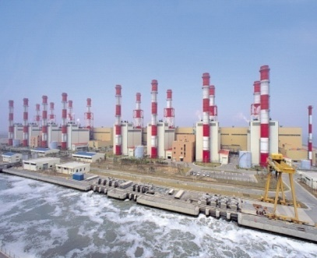

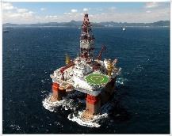

5. Applications for Butterfly Valves
5.1 Applications
OIL & GAS
Upstream
Downstream
Pipeline & storage
Supply & service
POWER
Geothermal
District heating
Nuclear
Desalination plants
Water works
steam
APPLICATION
OTHER INDUSTRIES
Iron & steel
Shipyard
Offshore
Automotive
PROECSS
Chemical & coal
Petrochemical
Food & beverage

Slide 33
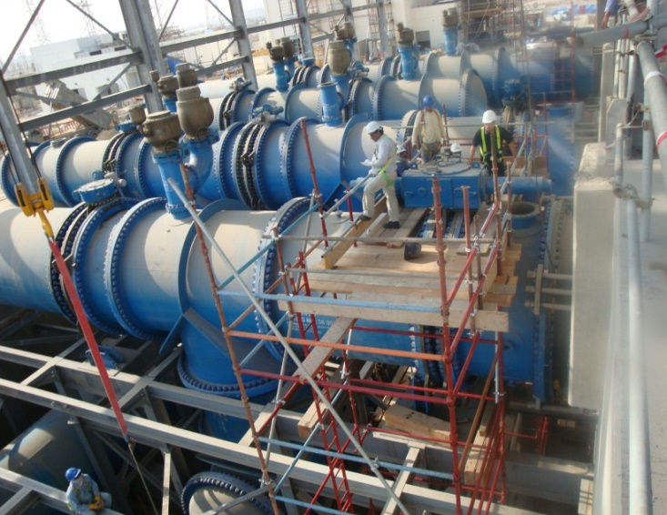
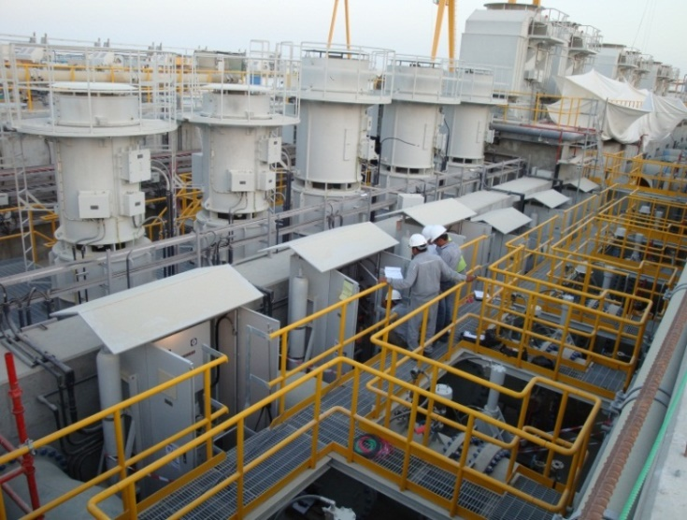
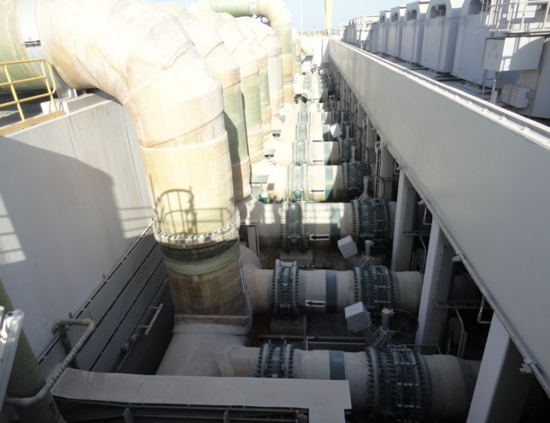
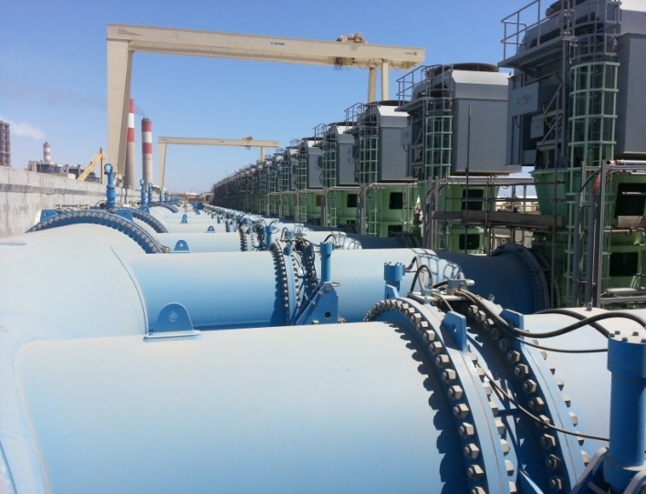
5. Applications for Butterfly Valves
5.1 Applications – Infrastructure(Desalination & Water Transmission)
▶ C31R PROJECT
- AL HARBY - DN 2800
▶ MARAFIQ POWER & DES. PROJECT
-Hyundai
Heavy
Industry
-DN 1950
▶ JEBEL ALI M PROJECT
- FISIA
- DN 1800
▶ RABIGH 2 PROJECT
- Doosan
Heavy
Industry
- DN 1800

Slide 34




5. Applications for Butterfly Valves
5.1 Applications – Power Plant
▶ SHUAIBAH IWPP PH.3 PROJECT
- Doosan
Heavy
Industry
- DN 1800
▶ SOHAR POWER & DES. PROJECT
- Doosan
Heavy
Industry
- DN 1000
▶ SHUAIBAH IWPP PH.3 PROJECT
- Doosan
Heavy
Industry
- DN 800
▶ RAS LAFFAN C IWPP PROJECT
- Hyundai
E&C
- DN 1600

Slide 35




5. Applications for Butterfly Valves
5.1 Applications – Oil & Gas Plant
▶MANIFA GAS FACILITY PROJECT
- GS E&C
- DN 1200
▶ PP13 & PP14 PROJECT
- WORLY PARSONS
- DN 600
▶CBDC PROJECT
- SECL
- DN 1050
▶ KNPC CFP project
Hyundai Heavy Ind.
DN400

Slide 36





6. Engineering Solution
6.1 Actual Test (Design verification)
6.1.1 Steam test ( Temperature + 132℃~172℃ )

Slide 37






6. Engineering Solution
6.1 Actual Test (Design verification)
6.1.2 Cryogenic Test ( Temperature -196℃ )

Slide 38
6. Engineering Solution
6.1 Actual Test (Design verification)
6.1.3 Raw Material test
Chemical Test
> Material & Spec
: ASTM Std.
Mechanical Test
> Tensile strength test
Mechanical Test
> Charpy impact test
High-frequency heat treatment
> Solution treatment 1100℃
> Increase of δ-Ferrite
N.D.E.(RT)
> ASME 16.34
> ASTM E446
Heat treatment
Time : 24 Hr
N.D.E.(MT & PT)
> ASME 16.34
> ASTM E125
>
P.M.I.
> ESA PORT
> ASME SEC. Ⅱ

Slide 39

6. Engineering Solution
6.2 TAT - Type Acceptance Testing (SHELL MESC SPE 77/300)
6.2.1 TAT Procedure
◆ Testing (MESC SPE 77/300 Appendix C Performance validation/C.4 Testing)
=> All TAT testings had been witnessed and verified by the nominated inspector(Bureau Veritas in Malaysia)
1. Ambient test
5. Low temperature test
Max Design test -196℃
2. High/elevated test
intermediate +200℃
4. Low temperature test
intermediate -20~ - 50℃
6. Ambient test
3. High/elevated test
Max Design test +400~500℃

Slide 40




6. Engineering Solution
6.2 TAT - Type Acceptance Testing (SHELL MESC SPE 77/300)
6.2.2 TAT - Ambient
Ambient Test
Ambient | Mech. Cycles
- 100% DP run-in; | (100x for ≤ 8”, 75x for 10” ≤ 16”, 50x for ≥ 18”)
- LP (2 bar) seat leakage & torque test; | (10x)
- Incremental seat leakage test (35%+70%+110% DP); | (6x)
- Shell/body test (110% DP);
- Dynamic and static FE test (100% DP); | (9x)
- HP (100% DP) seat leakage & torque test. | (2x)

Slide 41





6. Engineering Solution
6.2 TAT - Type Acceptance Testing (SHELL MESC SPE 77/300)
6.2.3 TAT - High / elevated Temperature intermediate
High / elevated temperature (intermediate, +200 °C): | Mech. Cycles
- Shell/body test (100% DP);
- Dynamic and static FE test (100% DP); | (25x)
41

Slide 42







6. Engineering Solution
6.2 TAT - Type Acceptance Testing (SHELL MESC SPE 77/300)
6.2.4 TAT – Low Temperature test intermediate , - 50 ℃
Low temperature (intermediate, -50 °C): | Mech. Cycles
- LP (2 bar) seat leakage & torque test; | (10x)
- Incremental seat leakage test (35%+70%+110% DP); | (6x)
- Shell/body test (110% DP);
- Dynamic and static FE test (100% DP); | (9x)
- HP (100% DP) seat leakage & torque test. | (2x)

Slide 43


6. Engineering Solution
6.2 TAT - Type Acceptance Testing (SHELL MESC SPE 77/300)
6.2.5 TAT - Come back to ambient temperature and inspection on disassembly
Ambient Test
Inspection on disassembly

Slide 44

6. Engineering Solution
6.2 TAT - Type Acceptance Testing (SHELL MESC SPE 77/300)
6.2.6 TAT - CERTIFICATE ( 31 ITEM )

Slide 45
7. Trouble Shooting
7.1 Concentric Butterfly Valve
Problem | Cause | Countermeasures
Leakage from Between the body and piping flange faces | The piping bolts are loose or they were not tightened evenly. | After reducing the pressure, loosen the piping bolts, and then retighten them by diagonal sequence.
 | The flanges or pipes are miss-aligned. | Remove the valve. Align the flanges/pipes and make the flanges/pipes parallel.
 | piping gasket is inserted or improper gasket is inserted | Do not insert any gasket between valve and pipe flange. Rubber seat ring is acting like a gasket.
Leakage from the gland bottom | The gland bolts are loose. The gland packing has worn out or has deteriorated. | Retighten the gland bolts. If leakage is not reduced, replace the gland packing.
 | The bottom bolts are loose. The bottom gasket has deteriorated. | If the hexagon bolts are loose, retighten them. If leakage is not reduced, replace the bottom gasket.
Valve seat leakage | There is damage to the disc or Seat due to the presence of foreign material inside the piping. | When the Seat is damaged, replace the Seat. If any abnormality is observed on the disc edge, replace the valve.
 | The full-close position of the disc is changed. (The actuator installation bolts are loose, etc.) | Clean the valve seat and adjust the full-close position correctly. In addition, check that there is no problem with the actuator output.
 | Wearing and deterioration of the Seat due to long period of use or high frequency of opening and closing operations | Replace the Seat.
 | Abnormal interference of the disc due to damage or deformation of the Seat. | Replace the Seat. If any abnormality is observed on the disc edge, replace the valve.
 | The valve is deformed or damaged. | Check the appearance of the body, disc and shaft to ensure that there is no deformation, dent, damage, corrosion, etc. If any of these are observed, replace the valve.

Slide 46





7. Trouble Shooting
7.2 Concentric Butterfly Valve – Claimed photos

Slide 47
7. Trouble Shooting
7.3 Double & Triple Offset Butterfly Valve
Problem | Cause | Countermeasures
Leakage from the gland bottom | The gland bolts are loose. The gland packing has worn out or has deteriorated. | Retighten the gland bolts. If leakage is not reduced, replace the gland packing.
 | Uneven tightening of the gland bolts. | Once loosened the bolts and evenly retighten them.
 | Damage on the gland packing | Replace the gland packing.
Internal through-bore leakage | Damage on the seat ring. | Disassemble and inspect the valve. Replace the seat ring.
Abnormal noise or vibration | Loosened bolts and nuts | Retighten the bolts and nuts
Excessive valve torque | Foreign objects may have stuck to the stem. | Remove the foreign objects and check the valve.
 | Foreign objects may have choked or stock around the seat ring. | Flush the valve bore with the fluid with the valve slightly open to remove the built-up objects or disassemble and inspect the valve
 | The gland bolts may have been overly tightened. | Loosen the gland bolts once and adequately retighten them so that the leakage through the gland does not occur.

Slide 48
7. Trouble Shooting
7.4 Double & Triple Offset Butterfly Valve – Periodic Check
Inspection Description | Inspection Points | Inspection Procedure | Countermeasures
External Leakage | Packing Gland area | Visual Check / Soap water | Retighten gland bolt. Change the gland packing
 | Connection area | Visual Check / Soap water | Retighten piping bolts. Change the gasket.
 | Body surface | Visual Check / Soap water | Change the valve.
Abnormal Noises | Valve body | Auditory check | Consult a piping engineer.
 | Loosened bolts | Auditory check | Retighten bolts.
 | Vibration of pipes | Auditory check | Contact a piping engineer
Corrosion and damage of the disc | Disc | Remove the valve from the piping and perform visual check. | Valve replacement
Abrasion and damage of the Seat | Seat | Remove the Seat from the piping and perform visual check | Clean the disc and Replace a Seat.
Seat leakage | - | - | Remove the foreign objects on seat liner. Disassemble and inspect the valve. Change the seat ring. Change the valve.
Valve operation | Valve position | Visual check | Make sure that the valve is in predetermined open/close position.
 | Disturbed operation | Visual and tactile check | Disassemble and inspect the valve
Loosened bolts and nuts | Bolts and nuts | Visual and Tactile check | Retighten bolts and nuts.

Slide 49



7. Trouble Shooting
7.5 Double Offset Butterfly Valve– Claimed photos

Slide 50
7. Trouble Shooting
7.6 Recommended Spare Parts
No. | Material | Description |  | Part No. | Qty (set) | Lead Time | Origin
Rubberlined Butterfly Valve (Concentric Design)
1 | EPDM or NBR |  | SEAT RING | SRS91X-ST-02 | 1 | 6 Weeks | Korea
2 | EPDM or NBR |  | PACKING | SRS91X-ST-11 | 1 | 6 Weeks | Korea
High Performance Butterfly Valve (Double Offset Design)
1 | EPDM or TEFLON or METAL or TEFLON+METAL |  | SEAT RING | SRS92X-ST-02 | 1 | 8 Weeks | Korea
2 | EPDM or TEFLON or GRAPHITE |  | PACKING | SRS92X-ST-11 | 1 | 6 Weeks | Korea
Water Works Butterfly Valve (Double Offset Design)
1 | EPDM or NBR |  | SEAT RING | SRS913-ST-02 | 1 | 8 Weeks | Korea
2 | EPDM or TEFLON or GRAPHITE |  | PACKING | SRS913-ST-11 | 1 | 6 Weeks | Korea
High Performance Butterfly Valve (Triple Offset Design)
1 | LAMINATED or METAL |  | SEAT RING | SRS92X-ST-02 | 1 | 8 Weeks | Korea
2 | GRAPHITE |  | PACKING | SRS92X-ST-11 | 1 | 6 Weeks | Korea

Slide 51
Thank You

